Slide 1
Hello and welcome to
Virtual Future Heroes Medicine session we will begin shortly.
Please mute your mics and switch off your cameras.
If you need technical assistance please use the chat box and we will be happy to help.

Slide 2
House Keeping Rules
Please mute your microphone and turn off your cameras. This will help us manage background noise during the presentations.
Please do not take any recordings or screen shots of the screen during the session
If you need any technical help during the event please message us using the chat box.
If you would like to ask a question please use the chat box. We will try to answer as many questions as possible at the end of the session and any we do not get to we will follow-up afterwards.
The session will be not be recorded live but we will be uploading the presentations to the Extra Heroes webpage after this session.
Please bear with us if there are technical issues we will resolve them as quickly as possible. You may find that some of the videos we play may buffer, we will share the links after the event for anyone who had any issues watching them.
Social media – please tag us in @hwe_academy and #Future Heroes
Most importantly – please join in with the quizzes and activities
Your feedback is important to use please feel free to email us – academy.hwe@nhs.net

Slide 3
Future Doctors
Dr Lucy Kempster, Dr Tumbi Otudeko & Dr Emiko Sykes

Slide 4
What will we cover?
Why medicine?
A day in the life of a doctor
Applying for medical school
Structure of a career in Medicine
Public Health Medicine – what is it and why is it important?

Slide 5
Why Medicine?

Slide 6
A Day in the Life of a Doctor
https://prezi.com/view/m5S8Cv4uUfwhJXoFENma/

Slide 7
Applying for Medical School
Subjects & Grades
UCAS Application (September-October)
4 medical school choices
Personal statement
References
Tests (UCAT, BMAT)
Interview
Notes:
GCSE – maths, science, english
A-level – Chemistry +/-Biology +/- Maths/physics
Foundation course for those who have mainly non-science Alevels
Earlier deadline vs other courses

Slide 8
What can I do now?
Research different medical schools
https://www.medschools.ac.uk/media/2701/msc-entry-requirements-for-uk-medical-schools-2021.pdf
Clinical Experience
Keep up to date
Think about your personal skills…
Notes:
Where, cost of living, different styles of learning, options for intercalation, rankings, how competitive, what grades required, facilities – medical and extracurricular
Paid, volunteering, work experience - shadowing

Slide 9
What skills do I have?
Communication
Leadership/management
Team work
Time management /organisation
Empathy
Problem-solving
Prefect
Band
Sports team
Part-time job
Captain
Orchestra
Volunteering
Debating team
Organised an event
Mentor
Play an instrument
Awards/achievements
…
Notes:
How are you suited to being a doctor?

Slide 10
Specialty Training
(3-8 years)
Options for further training
Medical School
(4-6 years)
Foundation Years
(2 years)
Public Health
GP Training
(3 years)
ACCS
Consultant
GP
Special Interest
Subspecialisation
Pathology
Surgery
Medicine
Paediatrics
Obstetrics & Gynaecology
Psychiatry
Radiology
A&E Anaesthetics ITU
What happens after medical school?
https://www.healthcareers.nhs.uk/explore-roles/doctors

Slide 11
What is Public Health?
“The art and science of preventing disease, prolonging life and promoting health through the organised efforts of society”
Public health focuses on the entire spectrum of health and wellbeing, not just treating diseases.

Slide 12
What is health?
Complete physical, mental and social wellbeing…
…rather than just the absence of disease

Slide 13
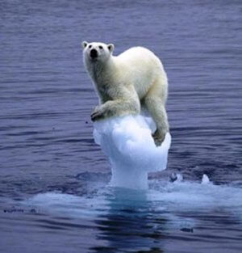
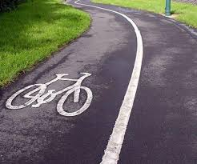
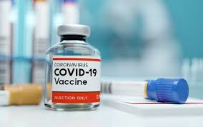
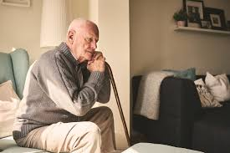
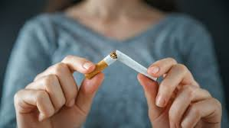

Slide 14
Health Protection
-Control infectious diseases
-Reduce environmental hazards (such as chemicals, poisons, and radiation)
-Help with public health emergencies e.g. Covid-19 pandemic
Health Improvement
-Societal interventions to improve health
e.g. housing, education, family & community life
-Aims to promote healthy lifestyles
Public Health Medicine
Healthcare Public Health
Improve healthcare services
Ensure treatments are based on up to date research

Slide 15
19th century: Safe drinking water and sewage disposal
1928: Penicillin discovered
1945: Fluoride added to water to prevent tooth decay
1796: First vaccine developed
1977: Smallpox is eradicated worldwide
1983: HIV discovered
2008: Climate Change Act
2020: Covid-19 pandemic
2007: Indoor smoking ban

Slide 16
Skills for Public Health
Leadership
Decision making
Problem solving
Data analysis
Communication
Strategic thinking
Team working
Research
IT skills

Slide 17
Questions
?

Slide 19
References
World Health Organisation, Public Health Services, https://www.euro.who.int/en/health-topics/Health-systems/public-health-services
C Guest, W Ricciardi, I Kawachi, I Lang. Oxford Handbook of Public Health Practice, third edition, pg. 573-577

Slide 20
Thank you
www.academy.healthierfuture.org.uk

