Slide 1
Midwifery
Claire Evans and Claire Henebery

Slide 2
What is a midwife
What does midwife mean?
‘With Woman’

Slide 3
What is a Midwife?
responsible and accountable professional
works in partnership with women
gives the necessary support, care and advice during pregnancy, labour and the postpartum period
A midwife is an autonomous practitioner.

Slide 4
Who can act as a midwife?
Midwifery is a protected function, making it a criminal offence for any person other than a registered midwife, or a registered medical practitioner, to attend on a woman in childbirth (except in emergencies or training). (NMC 2019)

Slide 5
How do you become a midwife?
Minimum requirements- UCAS points
University based programme of study
Degree level for direct entry
Option of masters level if already a qualified nurse

Slide 6
Do midwives just deliver babies?
Care begins from booking appointment by 10 weeks pregnant
Antenatal care throughout pregnancy
Labour and birth
Postnatal care up until 28 days
Specialist roles
University lecturer

Slide 7
What else does the midwife do?
preventative measures
the promotion of normal birth
the detection of complications in mother and child
the accessing of medical care or other appropriate assistance
the carrying out of emergency measures

Slide 8
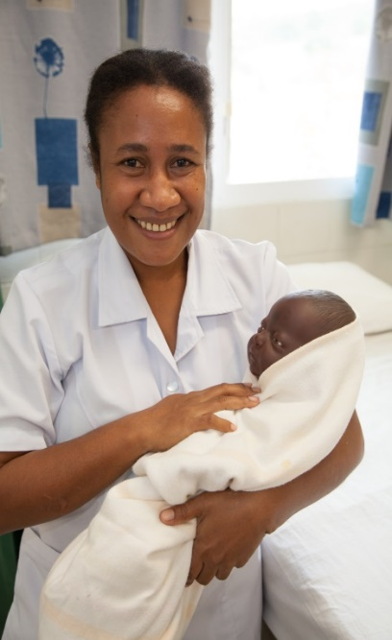
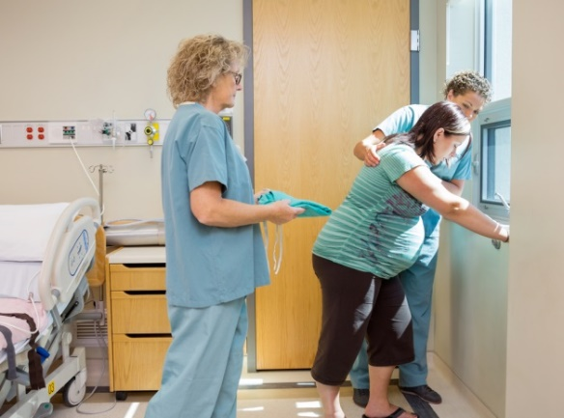
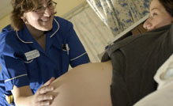
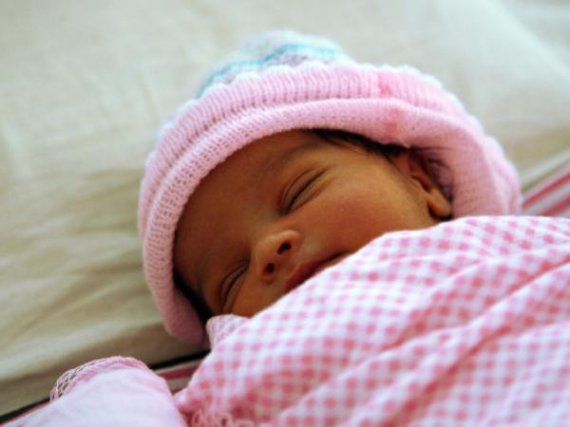
Questions?

Slide 9
www.academy.healthierfuture.org.uk
Thank you

