Slide 1
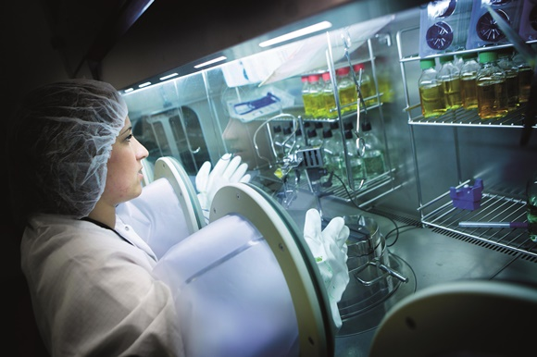
Other roles
Pharmaceutical Industry, including research, medicines advice and sales
Teaching
Drug and alcohol service
Prisons
Ambulance

Slide 2
Military
Captain Anuj K Sunder
Royal Army Medical Corps
Hospital pharmacist and Army Reserve
2018 - 4 month deployment to South Sudan as part of a United Nations Humanitarian Operation.

Slide 3
How do I become a pharmacy professional?

Slide 4
Pharmacist or Pharmacy technicians or assistant
Team worker
Flexible
Caring
Attention to detail
Friendly
Good communication skills
Skills & Attributes

Slide 5
Higher Education or not?
University
Pharmacist
Interest in science especially Chemistry
Lots of exams
Postgraduate education
No university
Pharmacy Assistant
Pharmacy technician
Interest in Science
Continuous assessments
Opportunities to progress with further training.

Slide 6
Pharmacy Assistant
No entry requirements
Work to achieve NVQ level 2 in Pharmaceutical Sciences
In hospital – band 2 or 3.

Slide 7
Pharmacy Technician
Apprenticeship route
5 GCSE’s including English, maths and science
Work to achieve a BTEC and NVQ level 3 in Pharmaceutical Sciences
2 year course
Band 3

Slide 8
Pharmacist
Masters in Pharmacy – 4 year degree at university
A level requirements – Chemistry + 2 others at grades A or B
One year pre-registration training with portfolio of competences and exam at end
In hospital - band 5 during training year
Band 6 once qualified

Slide 9
Why Pharmacy?- We asked our trainees
https://youtu.be/Cq32qmTw0Sw

Slide 10
Hospital Pay scale - starting salaries
Pharmacy assistant
£18,005
Student pharmacy technician
£19,737
Pre-registration pharmacist
£24,907
Newly qualified pharmacist
£31,365

